Slide 1
Tutorial 1 Learning Topology Optimization Through Examples and Case Studies
August 18, 2019

Slide 2
Thermo-elastic Topology Optimization

Slide 3
Why Thermo-Elastic TopOpt?
1. Wide applications
More challenging than purely elastic
2. Non-intuitive design
Notes:
Then, a question may pop up in your head “why we wanna solve this problem ?”
1. From airplane body, gears, to blades of windmill, there are so many structures that are subject to not only mechanical load but also thermal effects.
2. Traditionally, …. Topology optimization as a computer-aided-design tool, can save huge costs at conceptual stage.
3. Due to design-dependent thermal load effects, optimal designs for structures s.t. mechanical & thermal effects are usually non-intuitive.
It is arguably more challenging than pure elastic problems.

Slide 4
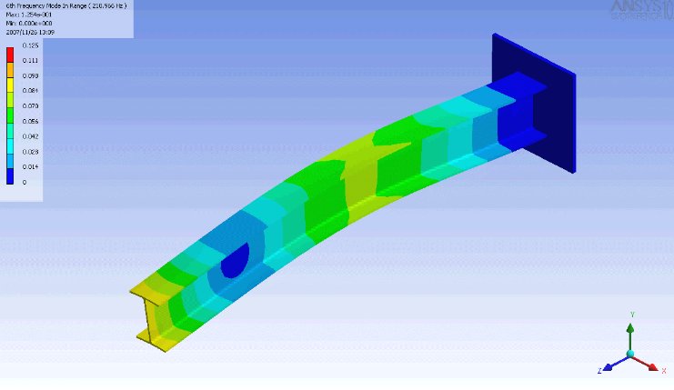
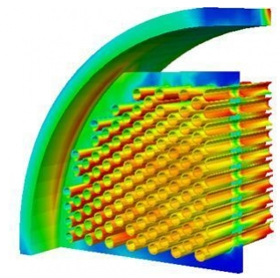
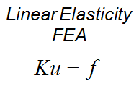
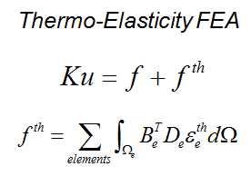
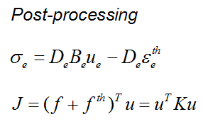
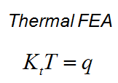
Thermo-elasticity
Notes:
First, Let’s look at what is the thermo-elasticity we used in this project.
1. classic
2. Weakly-coupled thermo-elasticity. In this case, only temperature variation will affect total load on the RHS of the equilibrium equ, but not the other way around.
3. During post-processing stage, variables like global max stress & compliance

Slide 5
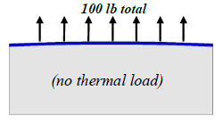
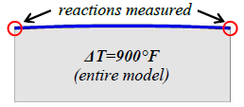
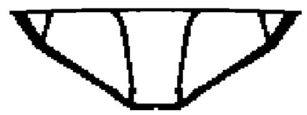
Three Thermo-elastic TopOpt Methods
Solid Isotropic Material with Penalization (SIMP):
M.P. Bendsøe, 1989
Deaton J. and Grandhi R. V., 2012
Most popular
Easy to understand and implement
Widely used
Singularity & ill-conditioning
zero slope at zero density
“gray” elements:
Stress-ambiguity
Notes:
Then, let’s review the 3 thermo-elastic TopOpt methods people usually used:
SIMP assigns pseudo-densities to finite elements, and optimize them to meet the desired objective
Apply SIMP to solve … problem. In their numerical example section, they illustrate how the optimal design can be achieved for structures s.t. distributed mechanical loads and uniformly T variation.
Widely used in different TopOpt problems: from fluids to non-linear structural mechanics
Because of the gray elements that are assigned intermediate pseudo densities, this method also suffers from lots of numerical problems:
In order to improve this disadvantage, some rsearchers adopted RAMP.
(1)the ill-conditioning of the stiffness matrices, due to low-density elements, can lead to high computational costs for iterative solvers (2)stress-ambiguity and accuracy over gray-elements
(3) big penalty still fail to guarantee “black and white” results

Slide 6
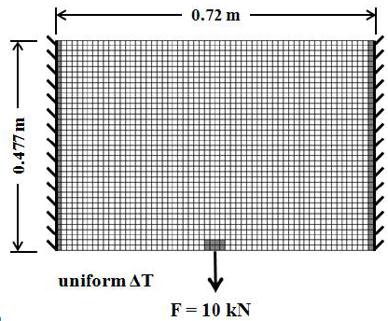
Three Thermo-elastic TopOpt Methods
Rational Approximation of Material Properties (RAMP):
Stolpe M. and Svanberg K., 2001
Deaton J. and Grandhi R. V., 2013
zero slope at zero density
Stress constraint &
better stress control
“gray” elements
Notes:
1. Compared with SIMP, RAMP used a different material interpolation scheme.
2. From their paper, they demonstrated superiority of RAMP over SIMP. They showed that: … disappeared, and they have better stress control and stress constraints over objective. But bcos of the gray elements, this method still suffers from many numerical problems.

Slide 7
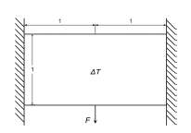
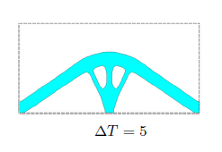
Three Thermo-elastic TopOpt Methods
Level-Set:
Osher and Sethian, 1988
Q. Xia and M. Y. Wang, 2008
LS-based boundary variation method
“gray” elements
well-defined boundary
well-defined domain
Domain need be initialized with holes
No guarantee on well-behaved K
Notes:
But because they relied on the Hamilton-Jacobi equations for level-set propagation, the domain have to be initialized with holes.
Because there is no guarantee the structure is well connected, thus there is no guarantee that the global stiffness matrix is well-behaved.
(The motion of the interface is matched with the zero level set of the level set function, and the resulting initial value PDE for the evolution of the level set function resembles a Hamilton-Jacobi equation.)
free boundary is design variable implicitly represented via level set model
geometric energy term is used to smoothen structural boundary

Slide 8
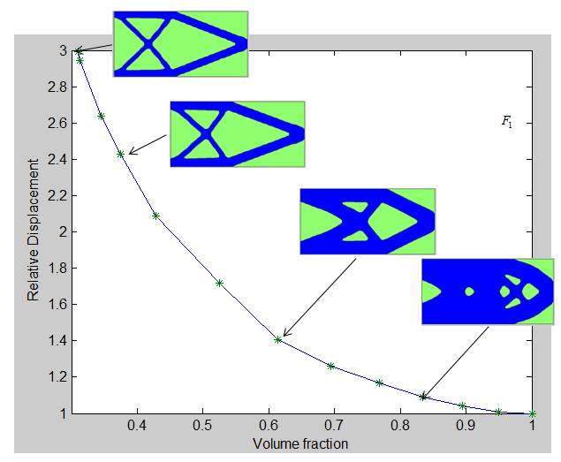
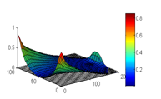
Proposed Method
Topological Sensitivity Level-Set method:
K. Suresh, 2010
Turevsky, I., Suresh, K., 2011
Takalloozadeh, M., Suresh, K., 2013
Domain need NOT be initialized with holes
Well-behaved K
Iterative solver
Large scale
Hard to derive & understand
Pure elasticity problems
Notes:
In order to get rid of the disadvantages, Suresh …. 2010. And along with Suresh, Turevsky and Takalloozadeh improved this method, respectively in 2011 and 2013.
Based on finite element solution, TS can be calculated. And based on TS, a series of PareTo solutions can be achieved.
Because we do not rely on HJ equ, domain need not to be ……. Connected: K, that is good for iterative solver and large scale TopOpt problem
Limited application to pure elasticity problem

Slide 9
Our Contribution
Topological Sensitivity Level-Set method:
Pure elasticity
Thermo-elasticity
Notes:
In this project, our contribution is clear: extending application scope of … from … to

Slide 10
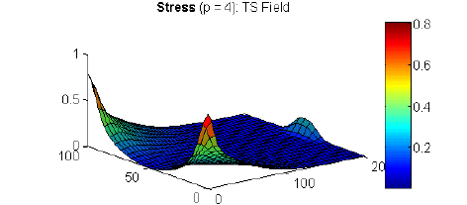
Objective & Constraints
Objective (choose one):
Minimize Compliance
Stiff Design
Minimize Stress
Strong Design
Multiple Constraints:
Compliance Constraint
Stress Constraint
Notes:
We have 2 different objectives to minimize: compliance and stress. And we use stiff design and strong design to refer to the final designs obtained by J minimization and S minimization, respectively.
For each objective, we can set two constraints. stress constraints. For J constraint, it sets a upper limit for the ratio between current J and initial J. It’s the same for stress constraint.

Slide 11
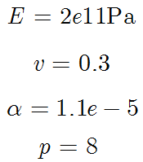
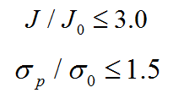
Numerical Experiments
Programming environment:
For all Experiments:
MATLAB: 2D
System Specifications:
Processor: AMD FX(tm)-8150 Eight-Core Processor
Constraints:
Study effect of:
Notes:
1 Our codes are implemented in matlab.
2 It is running on AMD…
3 Constraints are set the same for all the experiments
4 we study the effects of temperature variation and objectives on the final topologies

Slide 12
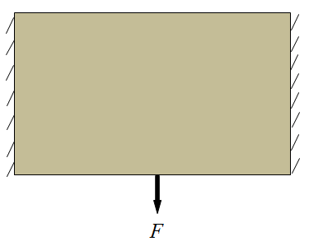
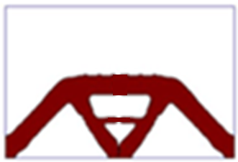
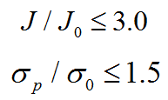
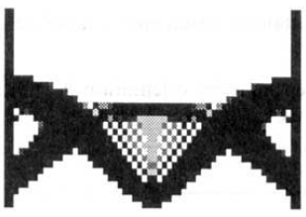
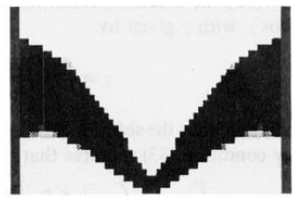
Bi-clamped beam with center load
Stiff Design
Strong Design
Stiff Design
Rodrigues and Fernandes, 1995
Notes:
1 Rows represent different objectives; columns represent temperature variations
What can you get by comparing those 4 topologies?
2 compared with topologies in columns, topologies in rows are more different. It means temperature variation plays a bigger role in determining the topologies.
3 Compared with previous results, although they look different due to different constraints & volume fraction, they share similarities. You can clearly see checkerboard pattern and grey elements in those early SIMP results.
Look at those topologies, do you really think designers have intuition to draw out different designs for slightly different temperature change? Such designs are non-intuitive. That’s where the power of this study comes from.

Slide 13
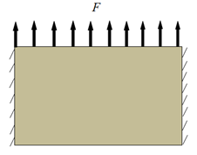
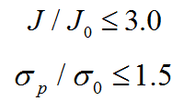
Bi-clamped beam with distributed loads
Stiff Design
Strong Design
Stiff Design
Rodrigues and Fernandes, 1995
Notes:
Compared with early results, we can clearly see checkerboard pattern and grey elements in those SIMP results.

Slide 14
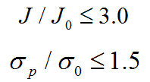
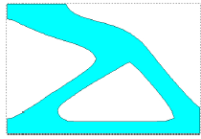
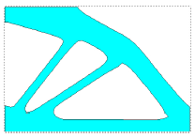
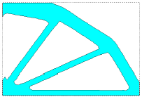
Clamped beam with tip load
Stiff Design
Strong Design
Stiff Design
Xia and Wang, 2008
Notes:
1 If you compare topologies in rows and columns, they both look different. It means both objectives & temperature variation affects final topologies.
2 Compared with previous results, they share similarities. And for the differences, we need future investigation.

Slide 15
Conclusion
1. Thermo-elastic TopOpt
Not trivial
Not intuitive
2. The impact of temperature
Significant
Negligible
3. Limitations
Augmented Lagrangian method
More constraints: buckling, eigen-value
3D, Parallelization
Notes:
… is not easy compared with pure elastic TopOpt
… is not intuitive due to the design-dependent thermal loads
A plausible reason is: when mechanical load is much stronger than thermal load. Its TS is very close to pure mechanical TS, so that the final design is close to the pure mechanical problem. In this case, thermal effects are negligible.
This project also has its limitations that we need to improve in the future work:
Use ALM to absorb more constraints

